Slide 1
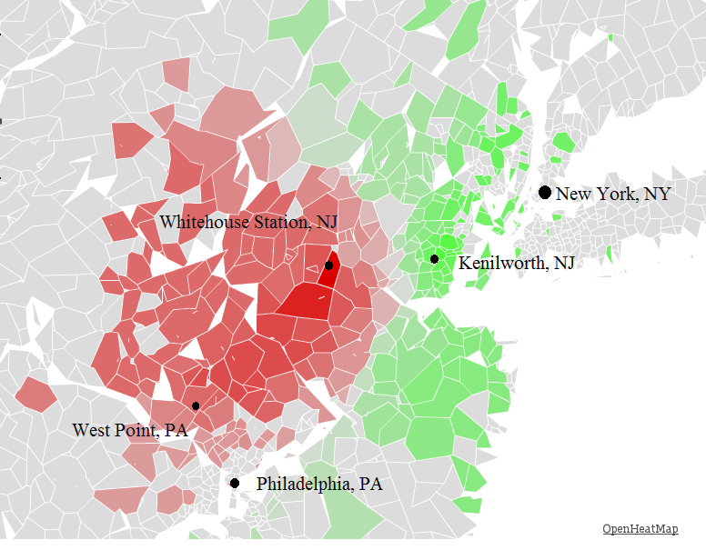
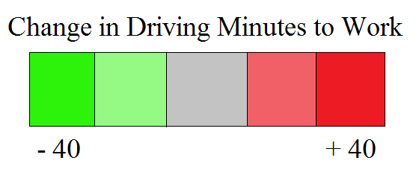
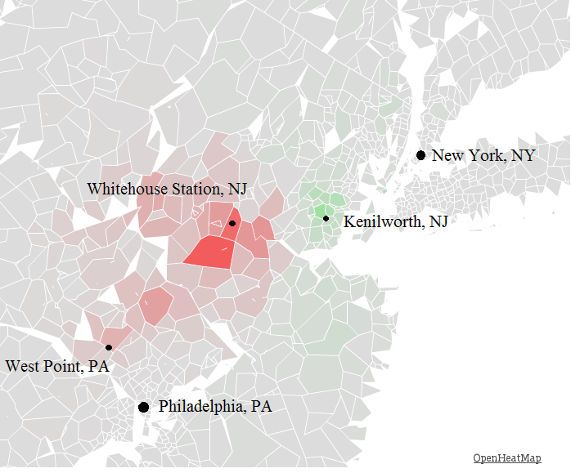
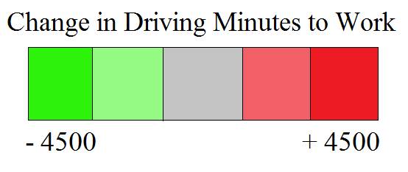
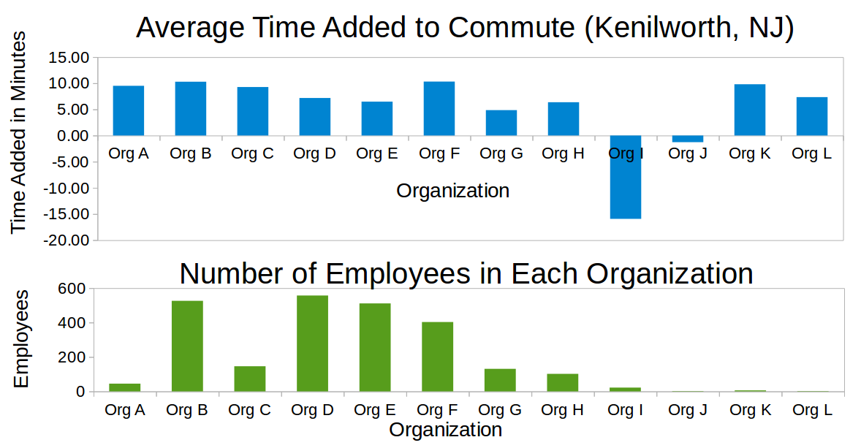
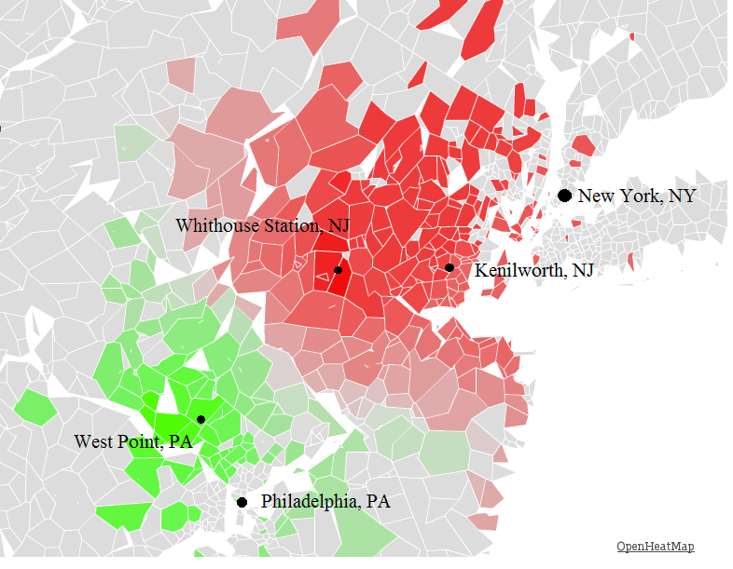
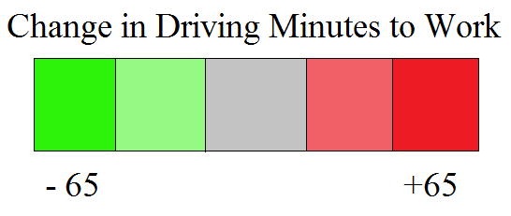
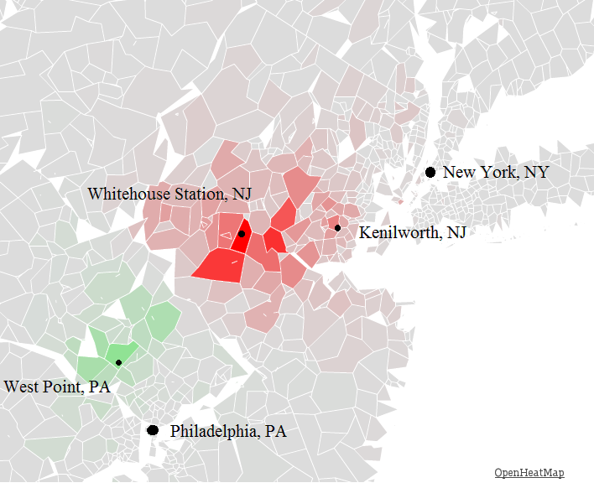
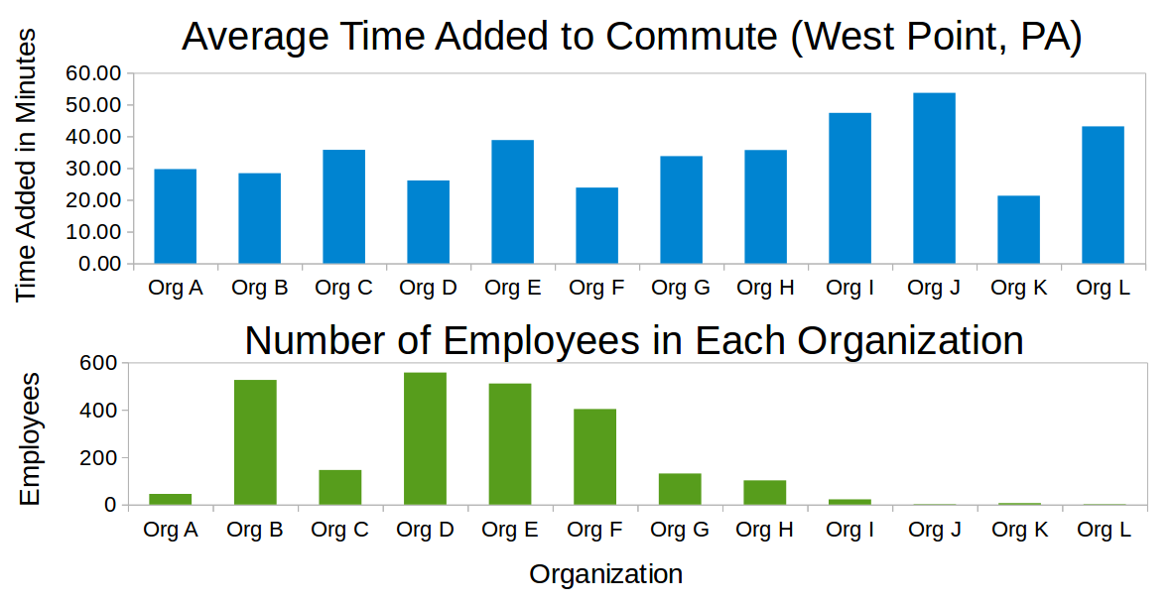
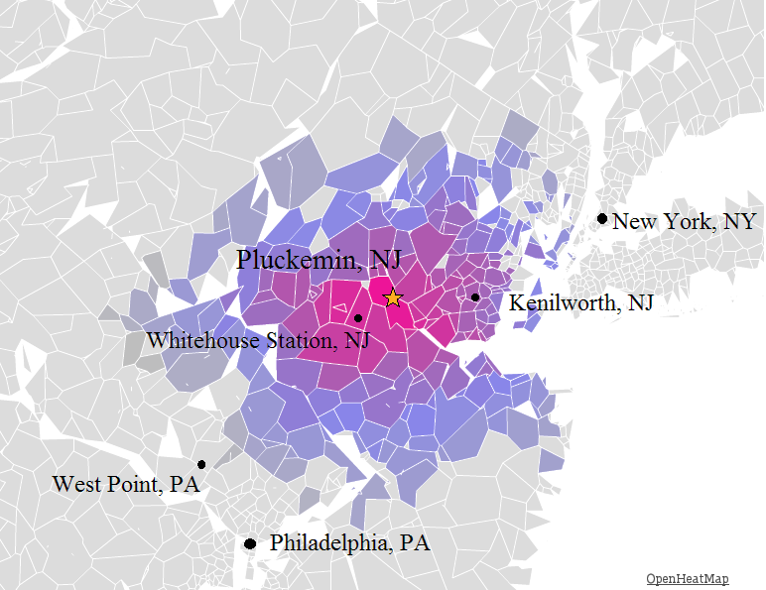

Merck Challenge
Alexander Arocho (TUD16565)
ChiehJeng Chen (TUC57478)
Christian D. Valenti (TUF31440)
Effect of Kenilworth, NJ relocation
Time Added to Commute per Zip Code
The brighter green a zip code is colored, the greater the time saved in commute duration. Inversely, the darker red represents a longer commute.
Interactive Map available at: http://www.openheatmap.com/view.html?map=ConcubinarianIntercommunionXenic
Time Added to Commute Weighted by Number of Employees
This map takes into consideration the number of employees in each zip code. The change in time is multiplied by the population in that zip code.
Interactive Map available at: http://www.openheatmap.com/view.html?map=XviiControversalLallations
Organizational Effect on Relocation
Effect of West Point, PA relocation
Time Added to Commute per Zip Code
The brighter green a zip code is colored, the greater the time saved in commute duration. Inversely, the darker red represents a longer commute
Interactive Map available at: http://www.openheatmap.com/view.html?map=SubcaudateCystogenousPygmyism
Time Added to Commute Weighted by Number of Employees
This map takes into consideration the number of employees in each zip code. The change in time is multiplied by the population in that zip code.
Interactive Map available at: http://www.openheatmap.com/view.html?map=FregataCumbernauldsDiluent
Organizational Effect on Relocation
Ideal site of relocation
To find the ideal location, we calculated the average employee commute time to all local zip codes. The brighter the purple, the lower the commute time. The star marks the most ideal location, Pluckemin, NJ, whose average commute time is approximately 29 minutes.
Interactive Map available at: http://www.openheatmap.com/view.html?map=EmpowermentsSphygmophonesOxydasic
All code can be found at: https://github.com/cdvalenti/temple_analytics

